Slide 1

Control of Robotic Manipulators using Q-Learning
TEAM 1
CB.EN.U4AIE19033 Kabilan N
CB.EN.U4AIE19053 Sabarishwaran G
CB.EN.U4AIE19062 Sri Gokul Prazath
19AIE311|RL|Control of Robotic Manipulators using Q-Learning

Slide 2
OBJECTIVE
Control the trajectory of end-effector of the 2R manipulator using Q-Learning
21AIE311|RL|Control of Robotic Manipulators using Q-Learning

Slide 3
WORKFLOW
METHODOLOGY
INTRODUCTION
CONCLUSION
THEORY
CODE & OUTPUT
21AIE311|RL|Control of Robotic Manipulators using Q-Learning

Slide 4
Introduction
21AIE311|RL|Control of Robotic Manipulators using Q-Learning

Slide 5
We will take set of actions and velocity & we’ll be finding the correct combination of action and velocity so that it produces maximum reward.
Reward is assigned by comparing the original trajectory and predicted trajectory. It will be maximum if the predicted trajectory is almost equal to the original trajectory.
We will use reinforcement learning (Q-Learning) to predict the trajectory
21AIE311|RL|Control of Robotic Manipulators using Q-Learning

Slide 6
Theory
21AIE311|RL|Control of Robotic Manipulators using Q-Learning

Slide 7
What is Q-Learning ?
Q-learning is an off policy reinforcement learning algorithm that seeks to find the best action to take given the current state. It’s considered off-policy because the q-learning function learns from actions that are outside the current policy, like taking random actions, and therefore a policy isn’t needed. More specifically, q-learning seeks to learn a policy that maximizes the total reward.
The ‘Q’ in Q-learning stands for quality. Quality in this case represents how useful a given action is in gaining some future reward.
21AIE311|RL|Control of Robotic Manipulators using Q-Learning

Slide 8
Methodology of Q-Learning
Step 1: Creating Q-Table of size ( state, action ) with initial values as 0’s.
Step 2: The next step is simply for the agent to interact with the environment and make updates to the state action pairs in our q-table
There are two actions Exploiting and Exploring
21AIE311|RL|Control of Robotic Manipulators using Q-Learning

Slide 9
Exploiting and Exploring
Exploiting: The first is to use the q-table as a reference and view all possible actions for a given state. The agent then selects the action based on the max value of those actions. This is known as exploiting
Exploring: Instead of selecting actions based on the max future reward we select an action at random. Acting randomly is important because it allows the agent to explore and discover new states.
We can balance exploration/exploitation using epsilon (ε) and setting the value of how often you want to explore vs exploit
21AIE311|RL|Control of Robotic Manipulators using Q-Learning

Slide 10
Methodology of Q-Learning
The updates occur after each step or action and ends when an agent is reaching terminal point (Episode)
The agent will not learn much after a single episode, but eventually with enough exploring (steps and episodes) it will converge and learn the optimal q-values (q*).
3 Basic Steps
Agent starts in a state (s1) takes an action (a1) and receives a reward (r1)
Agent selects action by referencing Q-table with max value or by random (epsilon, ε)
Update q-values
21AIE311|RL|Control of Robotic Manipulators using Q-Learning

Slide 11
reward
Maximum estimated future value
$$Q_{new}\left(s_{t},a_{t}\right)=Q_{old}\left(s_{t},a_{t}\right)+α\left(r_{t}+γ.\max_{a}\left(Q\left(\left(s_{t+1},a \right)\right)\right)−Q_{old}\left(s_{t},a_{t}\right)\right)$$
$$Q_{new}\left(s_{t},a_{t}\right)=Q_{old}\left(s_{t},a_{t}\right)+α\left(r_{t}+γ.\max_{a}\left(Q\left(\left(s_{t+1},a \right)\right)\right)−Q_{old}\left(s_{t},a_{t}\right)\right)$$
Old Value
Discount co-eff
Old Value
Note: Here no policy updation occurs
21AIE311|RL|Control of Robotic Manipulators using Q-Learning

Slide 12
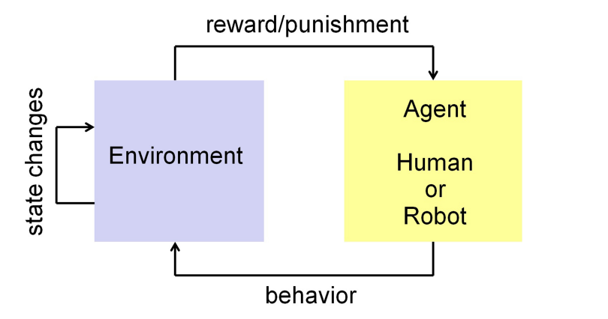
Deep Reinforcement Learning
Subset of machine learning.
Make an movement such that it receives maximum reward.
Here we don’t need any predefined training dataset.
Used in many domains, like game theory, control theory, operations research, information theory, system optimization, recommendation system and statistics.
21AIE311|RL|Control of Robotic Manipulators using Q-Learning

Slide 13
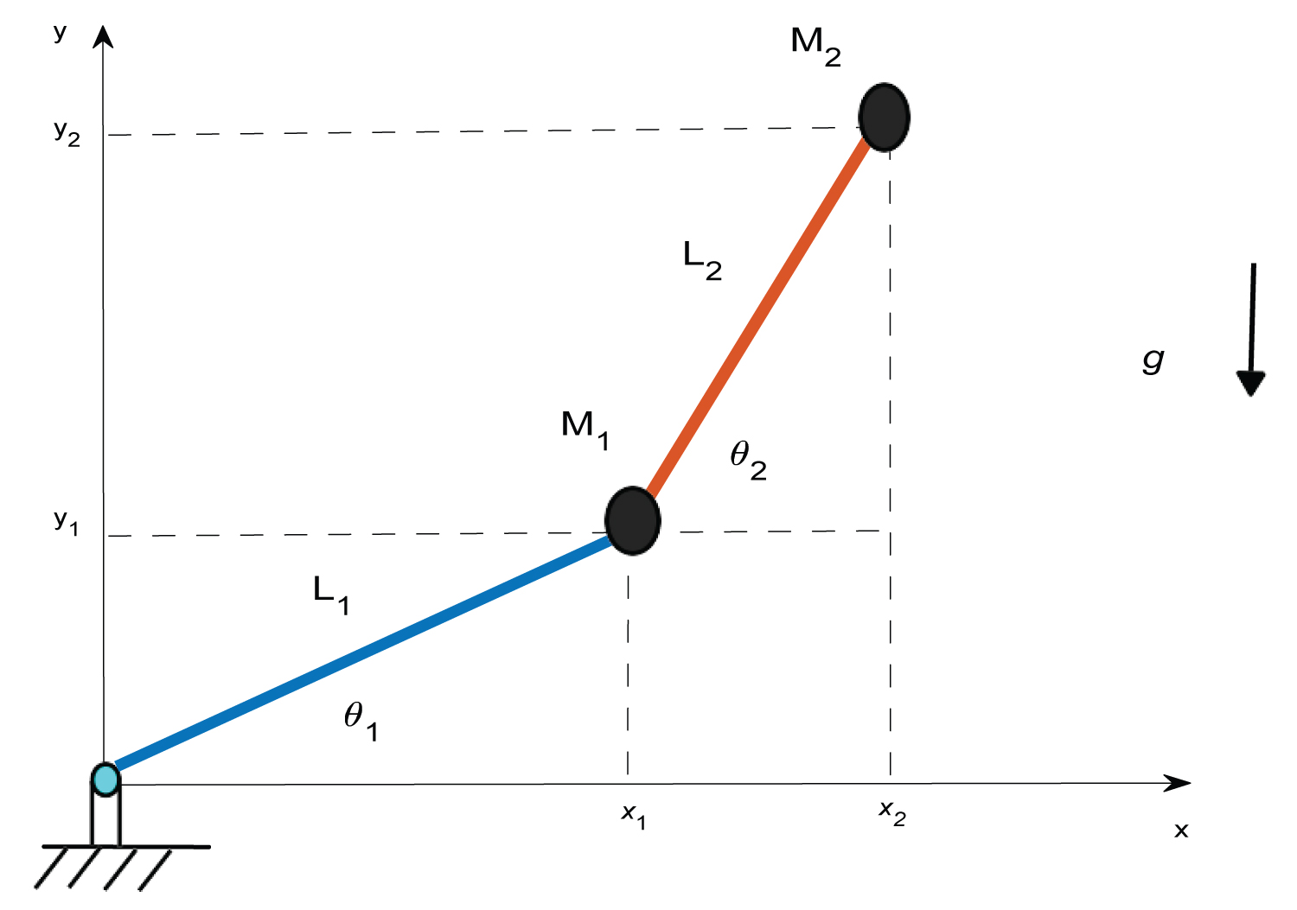
2R Planar Robot Arm
2R Planar Robotic arm contains 2 Revolute joints whose joint angle configurations that will put the end effector at a desired position.
m1, m2 = 2 ( Mass of the Links )
l1, l2 = 1 ( Length of the Links )
i1, i2 = 1 ( Inertia along COM of the link )
21AIE311|RL|Control of Robotic Manipulators using Q-Learning

Slide 14
Methodolgy
21AIE443|RL|Control of Robotic Manipulators using Q-Learning

Slide 15

Trajectory Control & Trajectory
$$s(t)=−4π{\left(\frac{t}{T}\right)}^{3}+6π{\left(\frac{t}{T}\right)}^{2}$$
$$q_{d}(t)=\left[\begin{matrix}π\cos{(}st) & π\sin{(}st)\end{matrix}\right]$$
Trajectory Control Variable
Trajectory Variable
We use cubic polynomial, because it is the lowest order that can be used to satisfy the position and velocity contains at the initial and final joint points
21AIE311|RL|Control of Robotic Manipulators using Q-Learning

Slide 16
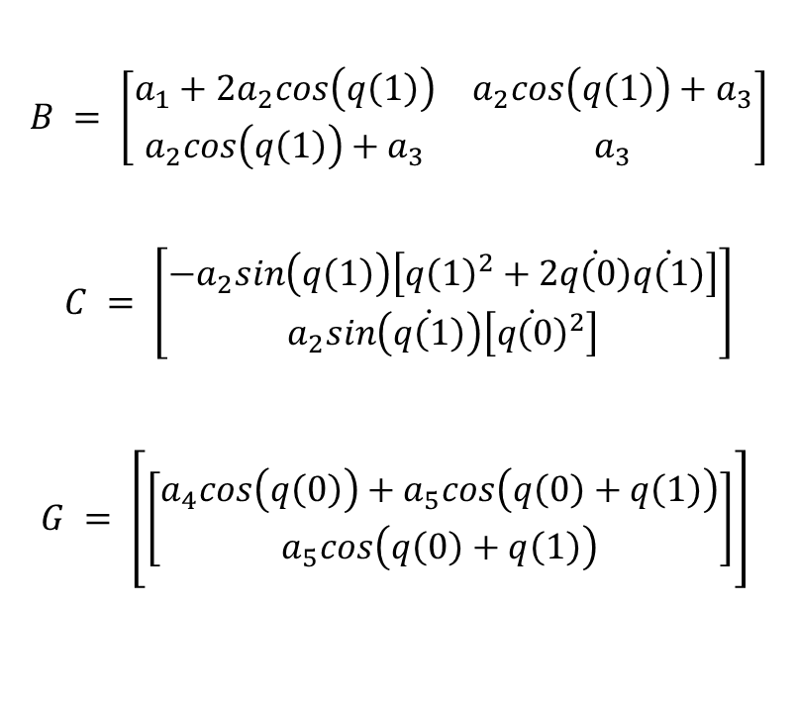
Dynamic Coefficients
$$B = \left[\begin{matrix}a_{1}+2a_{2}cos\left(q\left(1\right)\right) & a_{2}cos\left(q\left(1\right)\right)+a_{3} \\ a_{2}cos\left(q\left(1\right)\right)+a_{3} & a_{3}\end{matrix}\right]$$
$$C = \left[\begin{matrix}−a_{2}sin\left(q\left(1\right)\right)\left[{q\left(1\right)}^{2}+2\dot{q\left(0\right)}\dot{q\left(1\right)}\right] \\ a_{2}sin\left(\dot{q\left(1\right)}\right)\left[{\dot{q\left(0\right)}}^{2}\right]\end{matrix}\right]$$
$$G = \left[\left[\begin{matrix}a_{4}cos\left(q\left(0\right)\right)+a_{5}cos\left(q\left(0\right)+q\left(1\right)\right) \\ a_{5}cos\left(q\left(0\right)+q\left(1\right)\right)\end{matrix}\right]\right]$$
a1 ( Total Moment of Inertia about origin )
a2 ( Torque about revolute Joint 1 )
a3 ( Moment of Inertia on Link2 )
a4 ( Total Gravitational Torque )
a5 ( Gravitational torque for Link2 )
21AIE311|RL|Control of Robotic Manipulators using Q-Learning

Slide 17
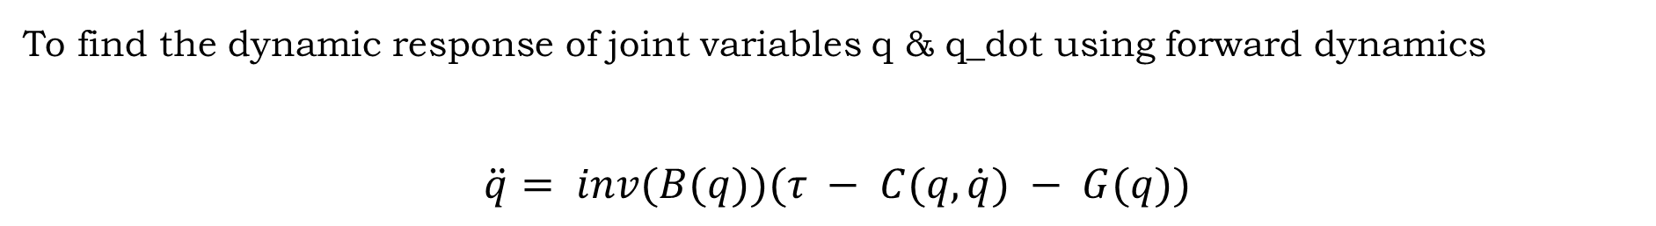
$$τ = B(q)\ddot{q} + C(q,\dot{q})\dot{q} + G(q)$$
Torque
Inertia Matrix
Gravitational Torque Matrix
Centrifugal & Coriolis Force Matrix
To find the dynamic response of joint variables q & q_dot using forward dynamics
$$\ddot{q}= inv(B(q))(τ − C(q,\dot{q}) − G(q))$$
21AIE311|RL|Control of Robotic Manipulators using Q-Learning

Slide 18




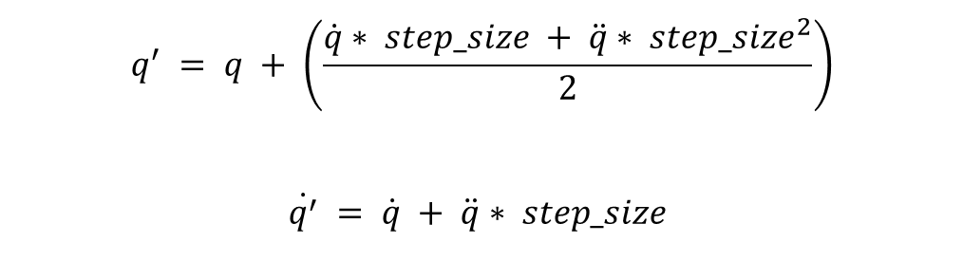
Forward Dynamics
$$q$$
$$q_{u}$$
$$\dot{q}$$
fwd_dyn
$$\ddot{q}= inv(B(q))(u − C(q,\dot{q}) − G(q))$$
u
$${\dot{q}}_{u}$$
Auxiliary Control Input
using this $\ddot{q}$ we update $q \& \dot{q}$
$$q^{′} = q + \left(\frac{\dot{q}∗ step_size + \ddot{q}∗ {step_size}^{2}}{2}\right)$$
$$\dot{q^{′}} = \dot{q} + \ddot{q}∗ step_size$$
21AIE311|RL|Control of Robotic Manipulators using Q-Learning

Slide 19
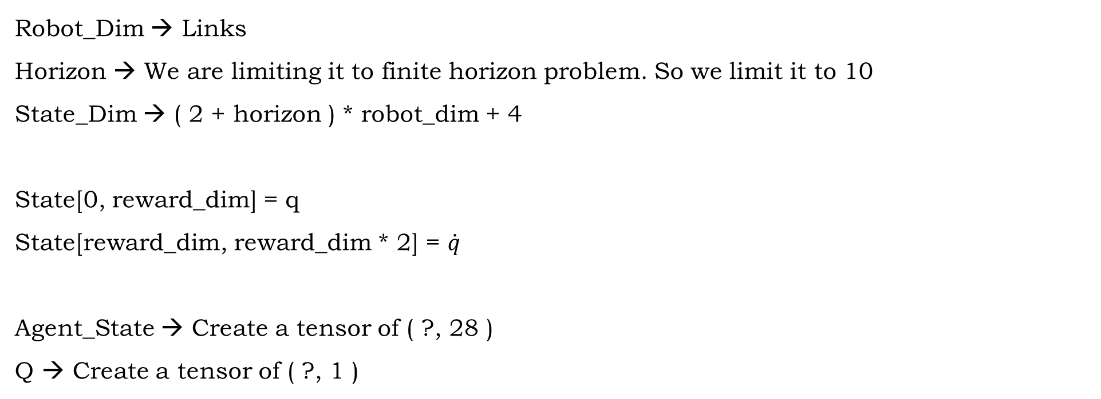
Robot_Dim → Links
Horizon → We are limiting it to finite horizon problem. So we limit it to 10
State_Dim → ( 2 + horizon ) * robot_dim + 4
State[0, reward_dim] = q
State[reward_dim, reward_dim * 2] = $\dot{q}$
Agent_State → Create a tensor of ( ?, 28 )
Q → Create a tensor of ( ?, 1 )
Kp, Kd → Gain
a_pos, a_vel
21AIE311|RL|Control of Robotic Manipulators using Q-Learning

Slide 20

Future Trajectory
time
future_trajectory
$\ddot{q}$ (t)
Finding $\ddot{q}$ for all horizons with the function given below which return updated $\ddot{q}$
$${\ddot{q}}_{d}(t)=\left[\begin{matrix}−π\cos{(}st){\dot{s}}^{2}−π\sin{(}st)\ddot{s} & −π\sin{(}st)\end{matrix}{\dot{s}}^{2}+π\cos{(}st)\ddot{s}\right]$$
21AIE443|RL|Control of Robotic Manipulators using Q-Learning

Slide 21
Weight Function
Create a random weight tensor of given shape
w1 → shape( 28, 128 )
w_out → shape( 1, 28 )
Bias Function
Create a random bias tensor of given shape
b1 → shape( 128, )
b_out → shape( 1, )
21AIE311|RL|Control of Robotic Manipulators using Q-Learning

Slide 22
Q Network
We create a feedforward network with two layers (Hidden layer and output layer)
hl → Hidden Layer hl1 = x*w1 + b1
hl1 = tanh(hl1)
ol → Output Layer ol = hl1*w_out + b_out
Learning Rate = 0.1
Loss Function → Root Mean Square Error
Optimization → Gradient Descent Optimization
Train → Minimize loss
21AIE311|RL|Control of Robotic Manipulators using Q-Learning

Slide 23
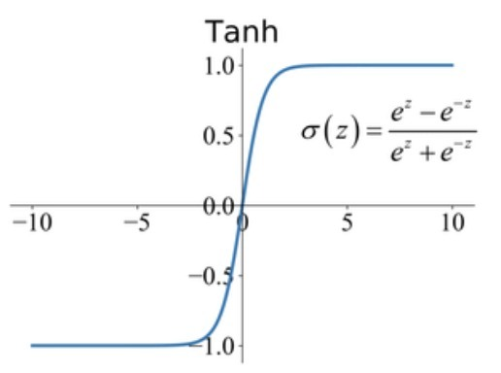

Reward
$r(s) = e^{− {||e_{q} ||}^{2}} + e^{− {||\dot{e_{q}}||}^{2}}$
Here if the error is more our reward will tend to 1 if it is less it will tend to -1 in order to make our robot direct in correct direction we have to maximize negative reward
Actions are incremented in a discrete fashion Position & velocity are incremented independently with position [+5, +3, 0, -3, -5] and velocity [+1, +0.5, 0, -0.5, -1]
21AIE311|RL|Control of Robotic Manipulators using Q-Learning

Slide 24
Gain Saturation
Since, it is difficult to cover the exact dynamic model. Then the closed loop controller ensure to vanishing the dynamic errors
Kp min – 10 Kd min -2
Kp max – 200 Kd max - 40
21AIE311|RL|Control of Robotic Manipulators using Q-Learning

Slide 25
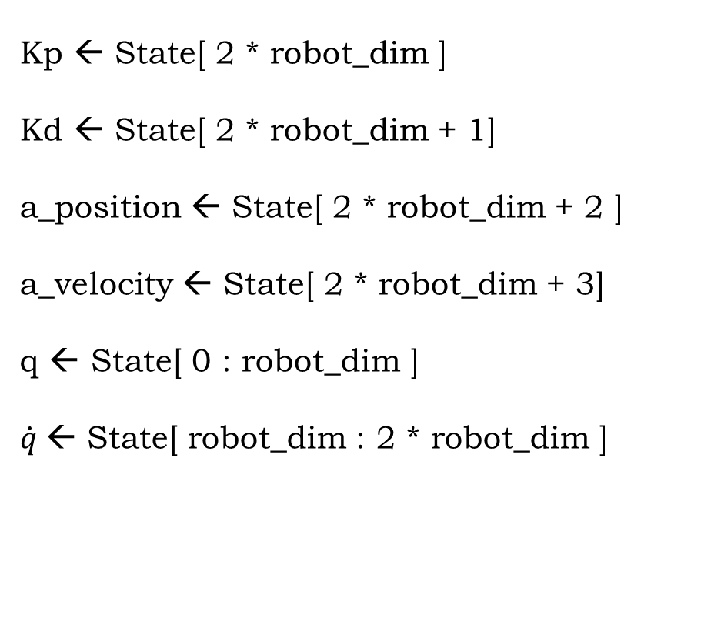
Run
State Varaiables:
Kp ← State[ 2 * robot_dim ]
Kd ← State[ 2 * robot_dim + 1]
a_position ← State[ 2 * robot_dim + 2 ]
a_velocity ← State[ 2 * robot_dim + 3]
q ← State[ 0 : robot_dim ]
$\dot{q}$← State[ robot_dim : 2 * robot_dim ]
21AIE311|RL|Control of Robotic Manipulators using Q-Learning

Slide 26

Work flow:
Calculating reward for time t
update gain( kp, kd )
for each horizon Calculate the auxiliary control input
$$u=K_{p}\left(q(t)−q\right)+K_{d}(\dot{q}(t)−\dot{q})$$
Update $\dot{q, q}$ using fwd_dyn
Update updated variables in state
21AIE311|RL|Control of Robotic Manipulators using Q-Learning

Slide 27
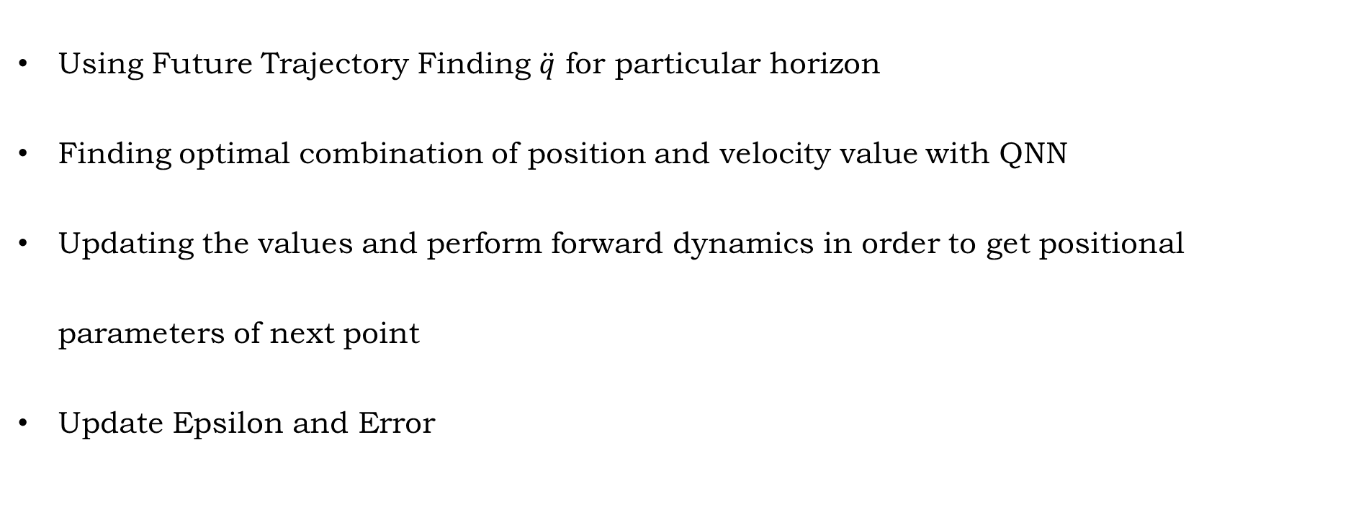
Main Function
Using Future Trajectory Finding $\ddot{q}$ for particular horizon
Finding optimal combination of position and velocity value with QNN
Updating the values and perform forward dynamics in order to get positional parameters of next point
Update Epsilon and Error
21AIE311|RL|Control of Robotic Manipulators using Q-Learning

Slide 28
Flow chart
Input Values
Future Trajectory
Random Policy Iteration
Run
Loss
Update Error
Output
21AIE311|RL|Control of Robotic Manipulators using Q-Learning

Slide 29
Code & Output
21AIE311|RL|Control of Robotic Manipulators using Q-Learning

Slide 30
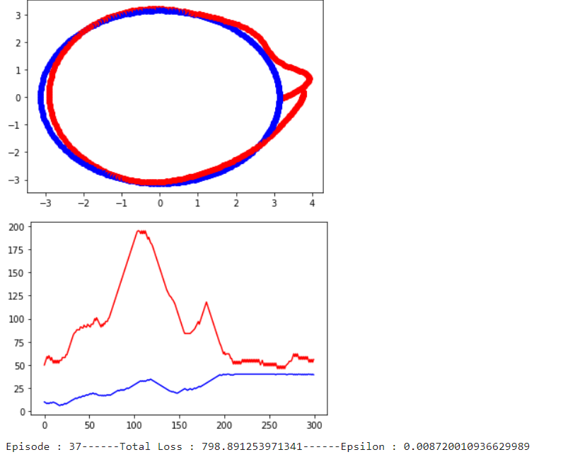
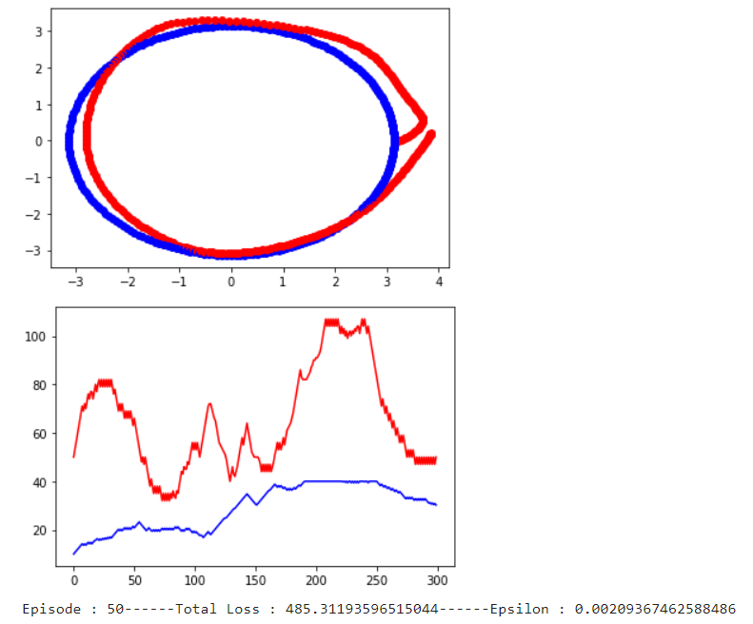
Output – Sample Episodes
21AIE311|RL|Control of Robotic Manipulators using Q-Learning

Slide 31
Future Works
We can use the same for complex robots
We can use actor critic or other temporal difference learning methods to get more accurate results
21AIE311|RL|Control of Robotic Manipulators using Q-Learning

Slide 32
References
Chen S, Luo M, He F. A universal algorithm for sensorless collision detection of robot actuator faults. Advances in Mechanical Engineering. January 2018. doi:10.1177/1687814017740710
Alwan, Hassan Mohammed and Zaid Hikmat Rashid. “Motion Control of Three Links Robot Manipulator (Open Chain) with Spherical Wrist.” Al-Khwarizmi Engineering Journal (2019): n. pag.
Miyamoto, Hiroyuki et al. “Feedback-error-learning neural network for trajectory control of a robotic manipulator.” Neural Networks 1 (1988): 251-265.
21AIE311|RL|Control of Robotic Manipulators using Q-Learning

Slide 33
Thank You!
21AIE311|RL|Control of Robotic Manipulators using Q-Learning

